Slide 1

HGF for Behavioural Analysis: Perceptual Model for Anxiety Patients During Lockdown
Branca Francesco, Menini Davide, Sangalli Sara

Slide 2








Motivation: Lockdown in Italy
Lack of sanitary goods
Project Idea
Tests
Tests
Today
Mar
Apr
May
Jun
2020
Lockdown
Phase 2
Notes:
We would like to briefly present the context that led us to the idea for this project. We are 3 Italian students whose families have lived the lockdown in first person. We wanted to gather our personal experience with the subject of the course.

Slide 3

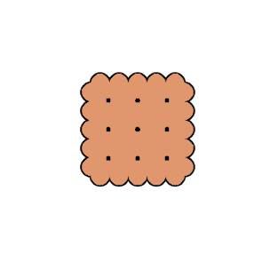











Goal: HGF for Anxiety Recognition
GOAL
Impartial Test
webapp
HGF
Psychologically Involving Test
webapp
HGF
Anxiety Quiz
webapp
HGF
Ground Truth

Slide 4

Experiment: Setup
Agents: 20-60 years old, both male and female
Tests randomly inverted to avoid concentration issues
Speed up of the response time limit
Impartial Test: Biscuits in shop A (y | n) Are there biscuits in shop B?
Involving Test: Sanitizers in shop A (y | n) Are there sanitizers in shop B?
Anxiety Quiz: 20 questions based on STAI. * 4 levels of anxiety detected, but only interested in a binary decision for results’ validation.
* https://en.wikipedia.org/wiki/State-Trait_Anxiety_Inventory

Slide 5
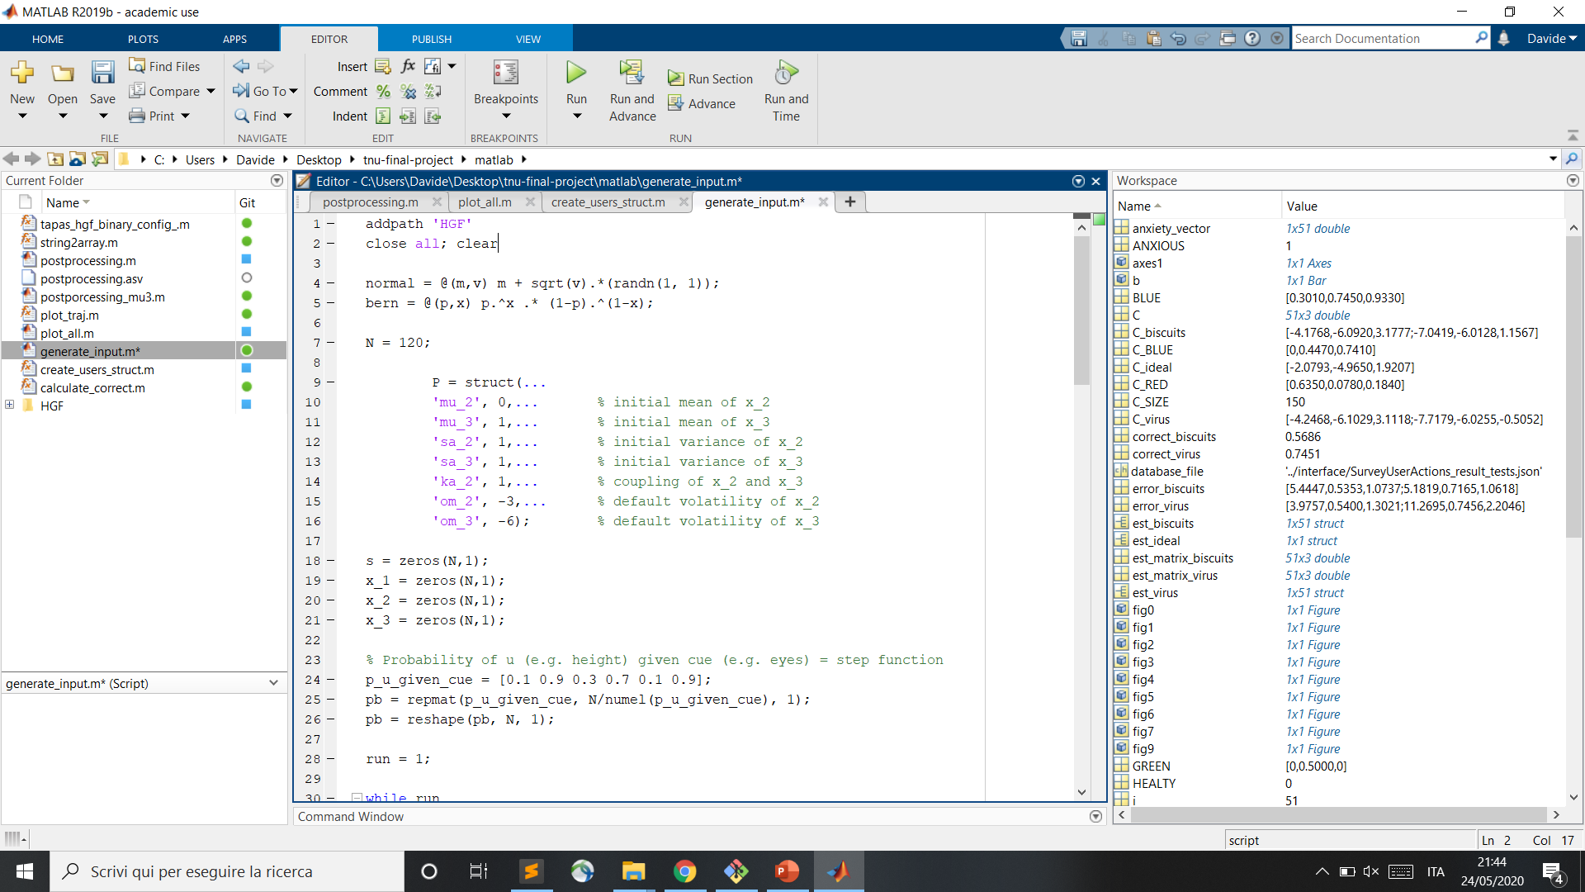
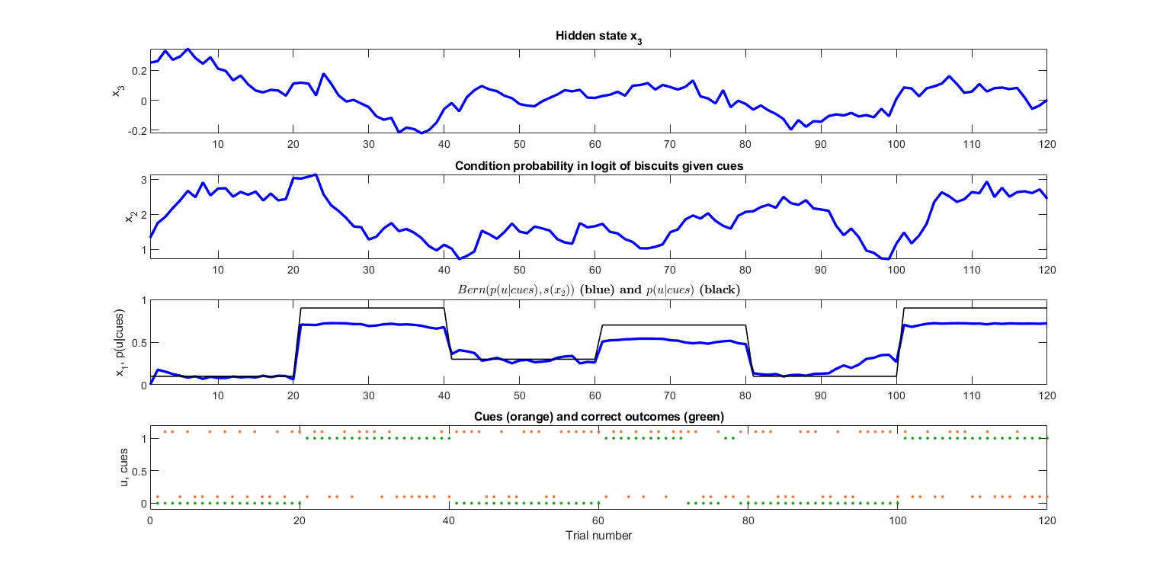
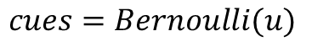
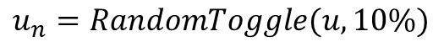
Experiment: Inputs
Correct Outcomes:
Cues:
Noisy Outcomes:
$$u=GenerativeModel(P, p(u|cues))$$
$$cues=Bernoulli(u)$$
$$u_{n}=RandomToggle(u, 10\%)$$

Slide 6
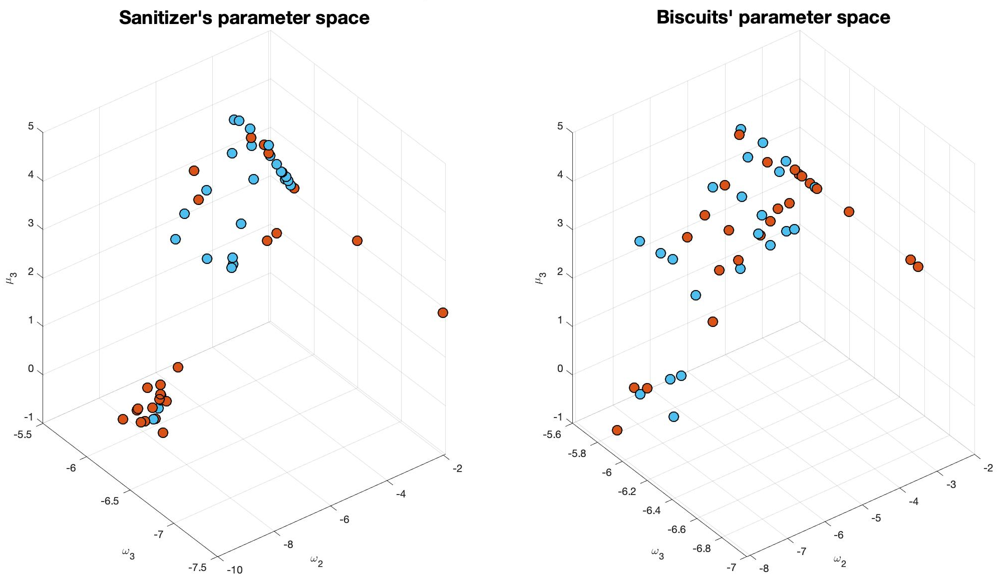
Parameters’ Estimation: Involving vs. Impartial
= Healthy Controls
= Anxious Patients
Notes:
Estimation of om2, om3 and mu3 using Tapas_fitModel. With the response model that we used, om2 and mu3 are exactly anticorrelated.

Slide 7
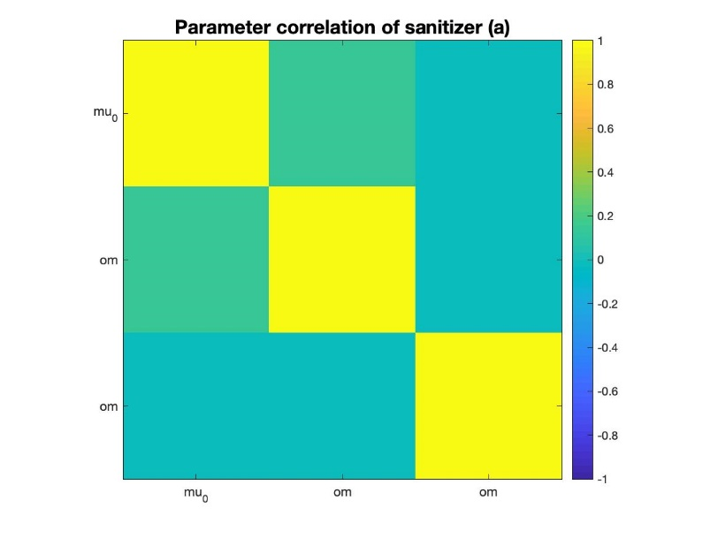
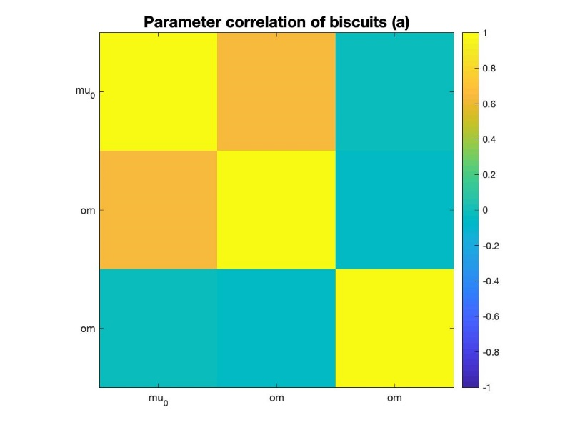
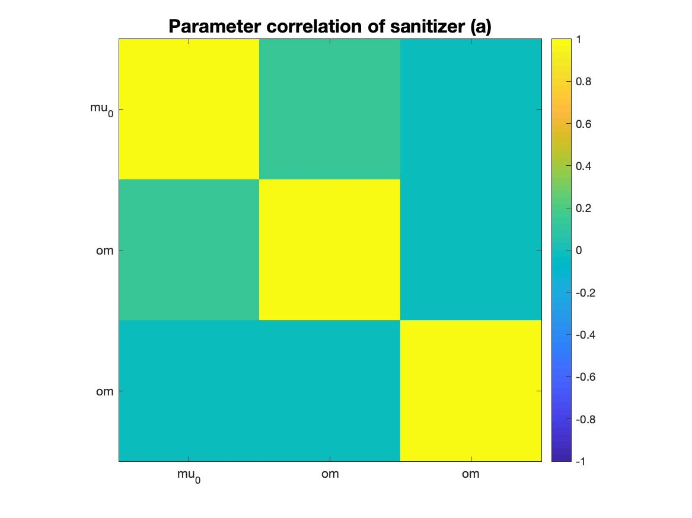
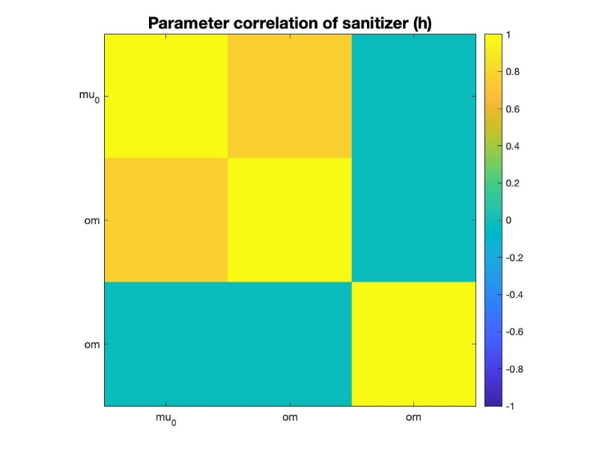
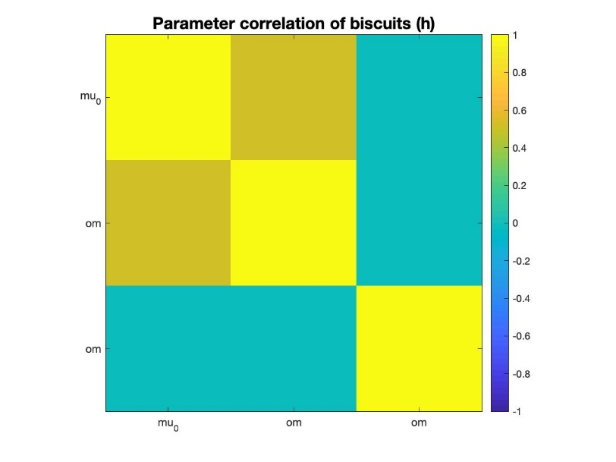
Parameters’ Correlation
Anxious
Healthy
Involving
Impartial

Slide 8
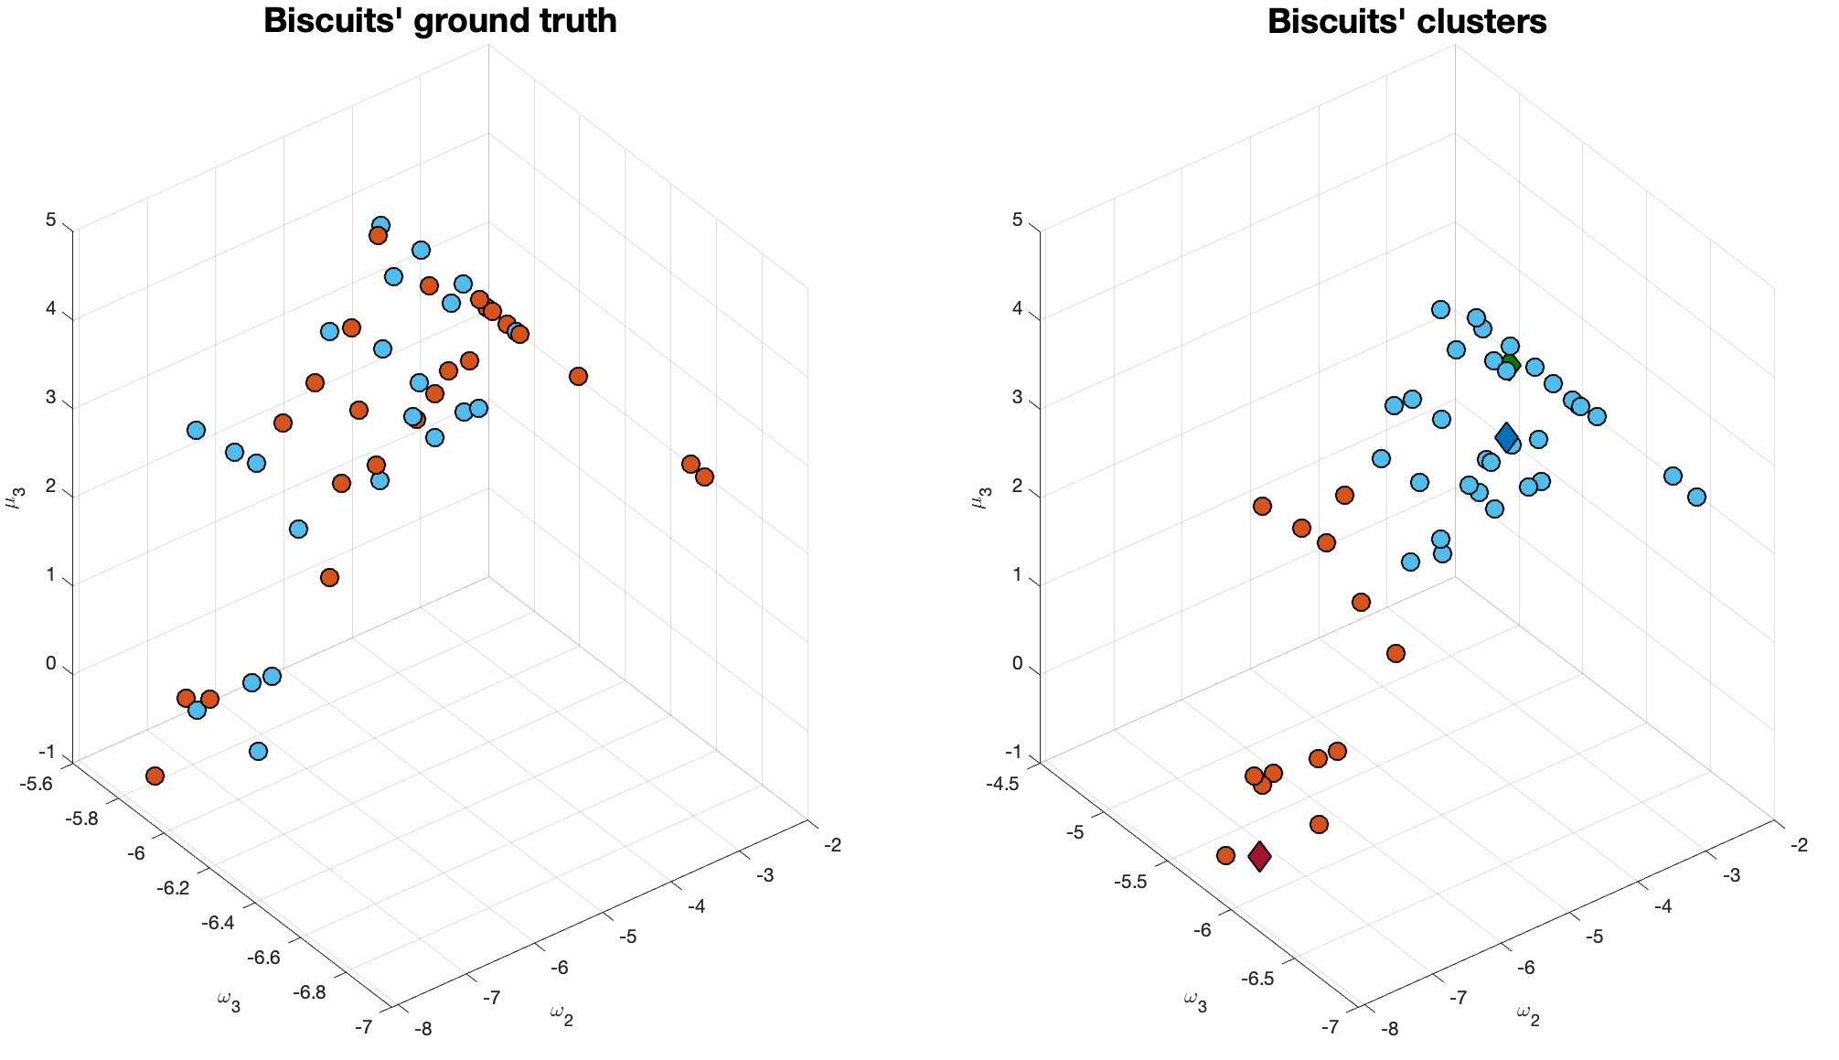
K-Means Clustering: Impartial Context
= Healthy Controls
= Anxious Patients
= Healthy Centroid
= Anxious Centroid
= Ideal Model

Slide 9
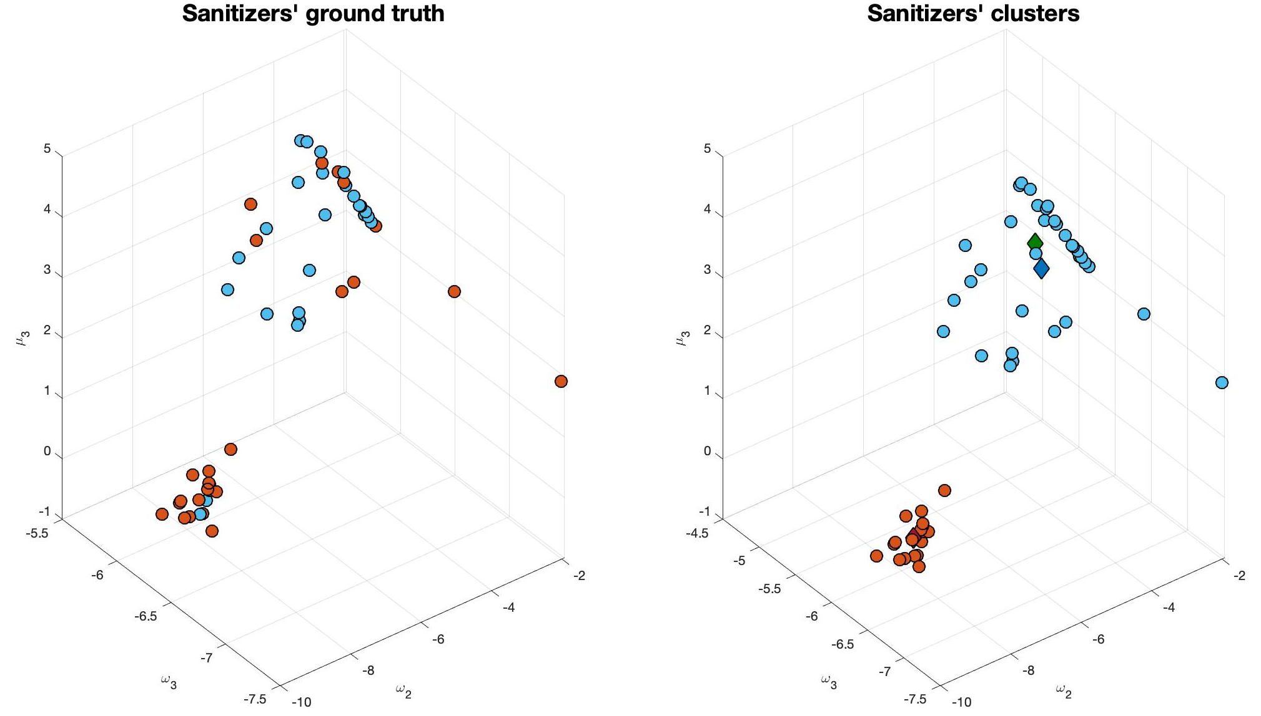
K-Means Clustering: Involving Context
= Healthy Controls
= Anxious Patients
= Healthy Centroid
= Anxious Centroid
= Ideal Model

Slide 10
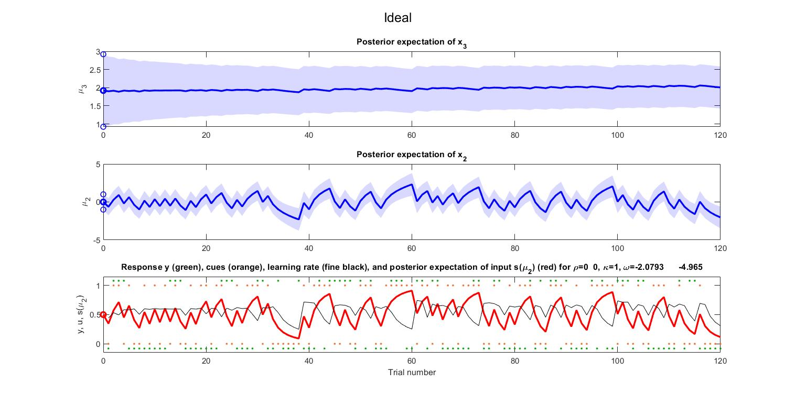
Simulation of the Ideal Model

Slide 11
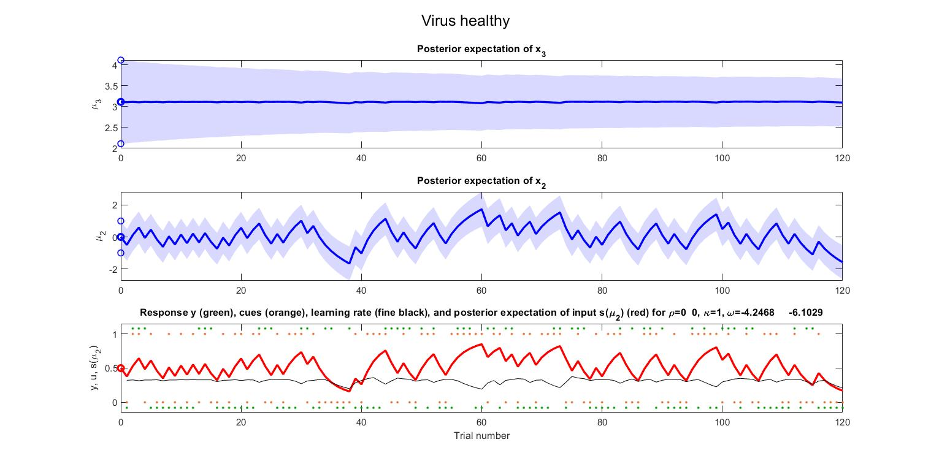
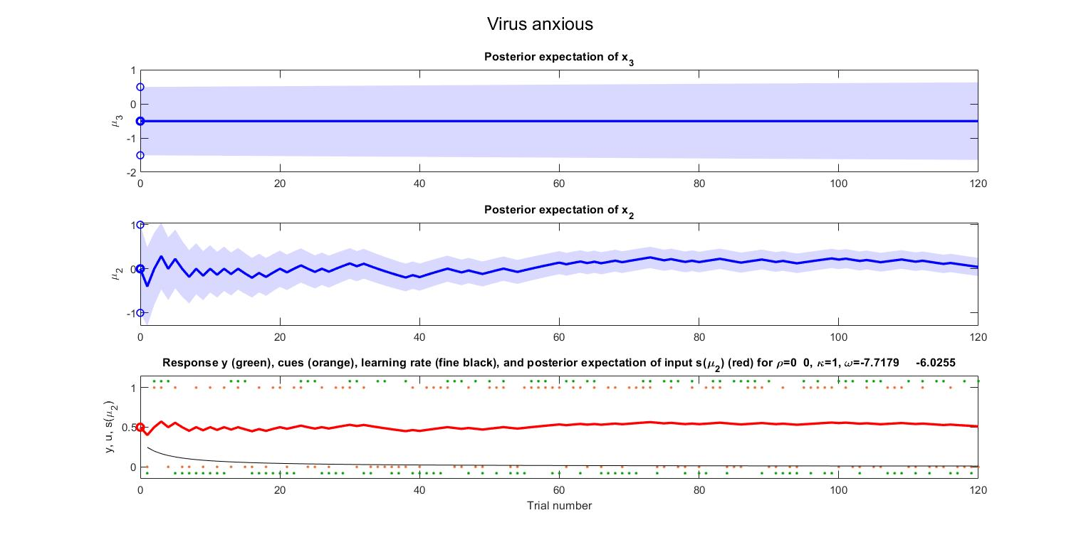
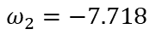
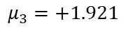
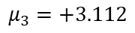
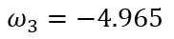
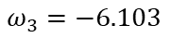
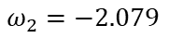
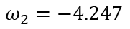
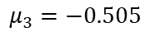
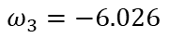
Comparison: Ideal vs. Involving Test’s Centroids
Ideal
SCORE = 53%
$$ω_{2}=−2.079$$
$$ω_{3}=−4.965$$
$$μ_{3}=+1.921$$
Healthy
SCORE = 50%
$$ω_{2}=−4.247$$
$$ω_{3}=−6.103$$
$$μ_{3}=+3.112$$
Anxious
SCORE = 46%
$$ω_{2}=−7.718$$
$$ω_{3}=−6.026$$
$$μ_{3}=−0.505$$

Slide 12

Thank you for your attention!
Branca, Francesco – fbranca@student.ethz.ch
Menini, Davide – dmenini@student.ethz.ch
Sangalli, Sara – sansara@student.ethz.ch
https://tnutest.altervista.org/

Slide 13
Back-Up Slides

Slide 14
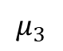
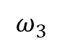
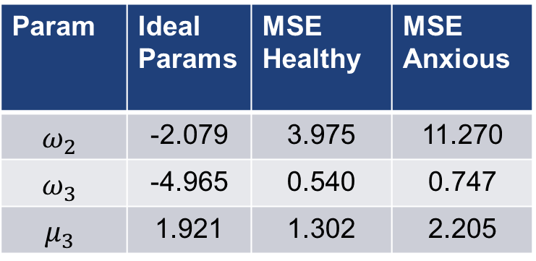
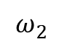
Comparison: MSE (Involving Test)
$$=MSE\left(est_ideal, est_h\left(i\right)\right) for i=1..N_h$$
$$=MSE\left(est_ideal,est_a\left(i\right)\right) for i=1..N_a$$
Healthy and anxious groups are based on ground truth
Param | Ideal Params | MSE Healthy | MSE Anxious
$$ω_{2}$$ | -2.079 | 3.975 | 11.270
$$ω_{3}$$ | -4.965 | 0.540 | 0.747
$$μ_{3}$$ | 1.921 | 1.302 | 2.205
$$ω_{2}$$
$$ω_{3}$$
$$μ_{3}$$

Slide 15
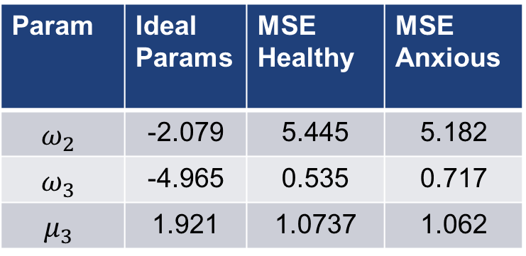
Comparison: MSE (Impartial Test)
$$=MSE\left(est_ideal, est_h\left(i\right)\right) for i=1..N_h$$
$$=MSE\left(est_ideal,est_a\left(i\right)\right) for i=1..N_a$$
Healthy and anxious groups are based on ground truth
Param | Ideal Params | MSE Healthy | MSE Anxious
$$ω_{2}$$ | -2.079 | 5.445 | 5.182
$$ω_{3}$$ | -4.965 | 0.535 | 0.717
$$μ_{3}$$ | 1.921 | 1.0737 | 1.062
$$ω_{2}$$
$$ω_{3}$$
$$μ_{3}$$

